Slide 1
Sales MaNagement Project using flask framework python

Slide 2
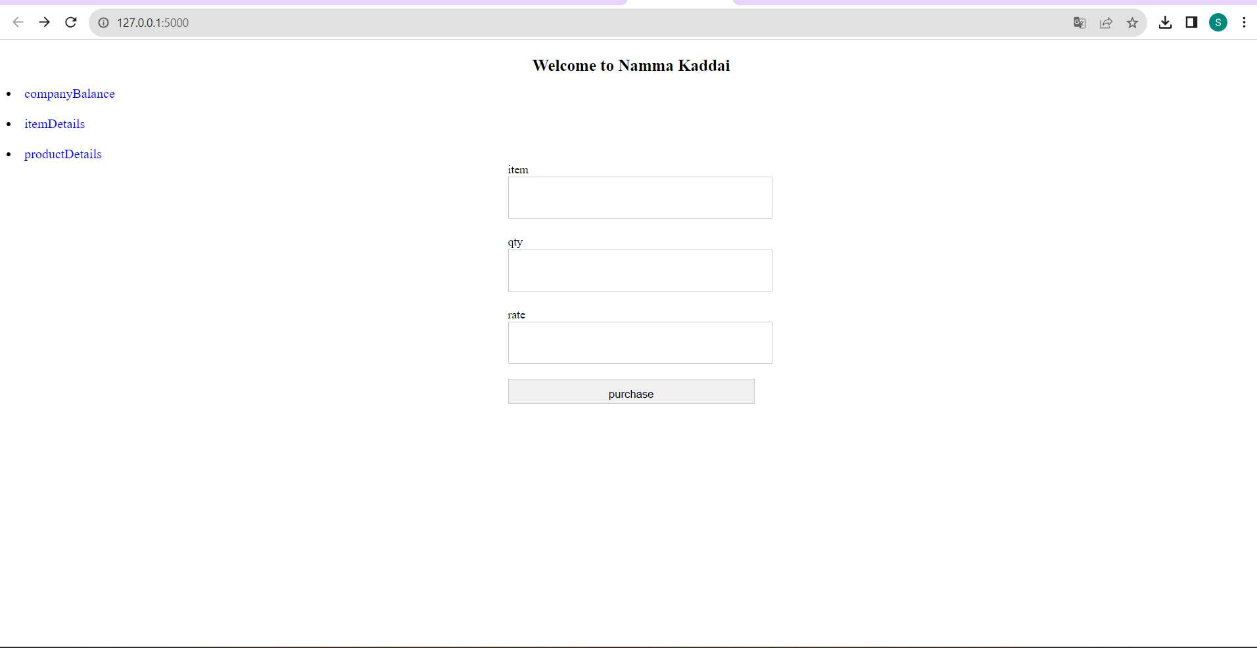
Purchase page

Slide 3
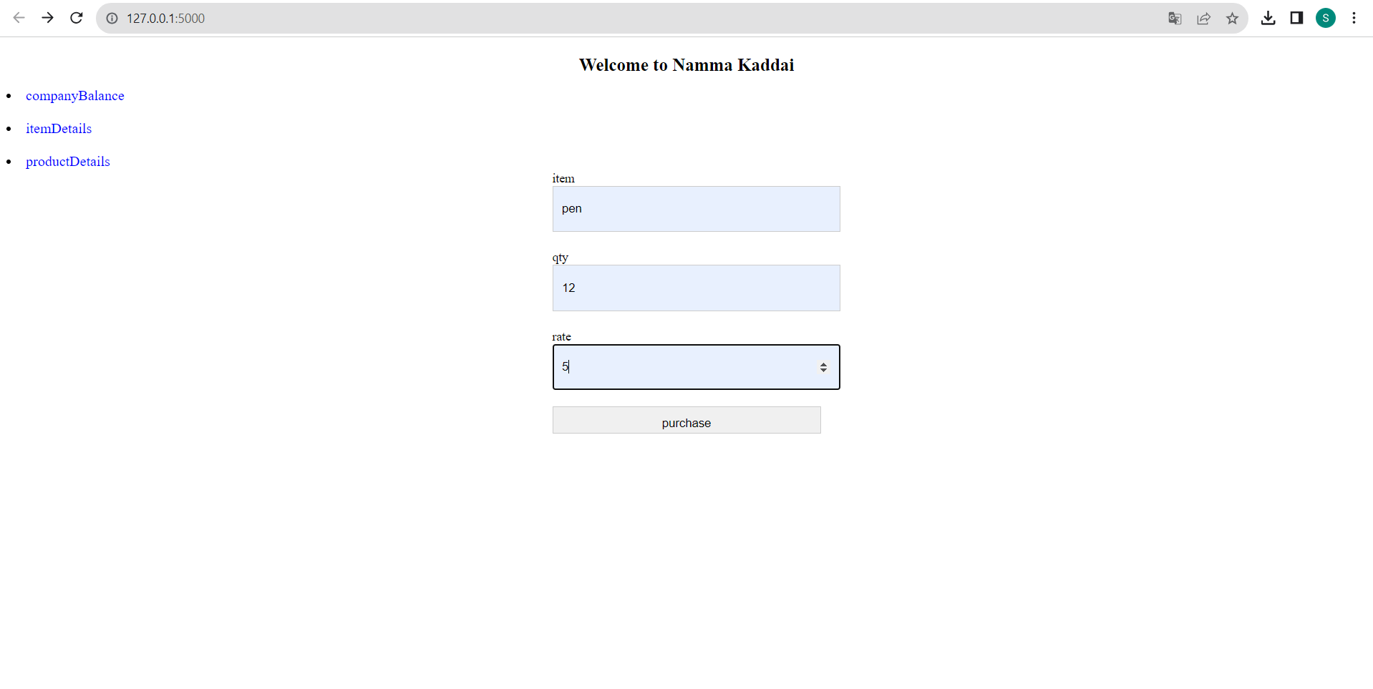
Purchashing product

Slide 4
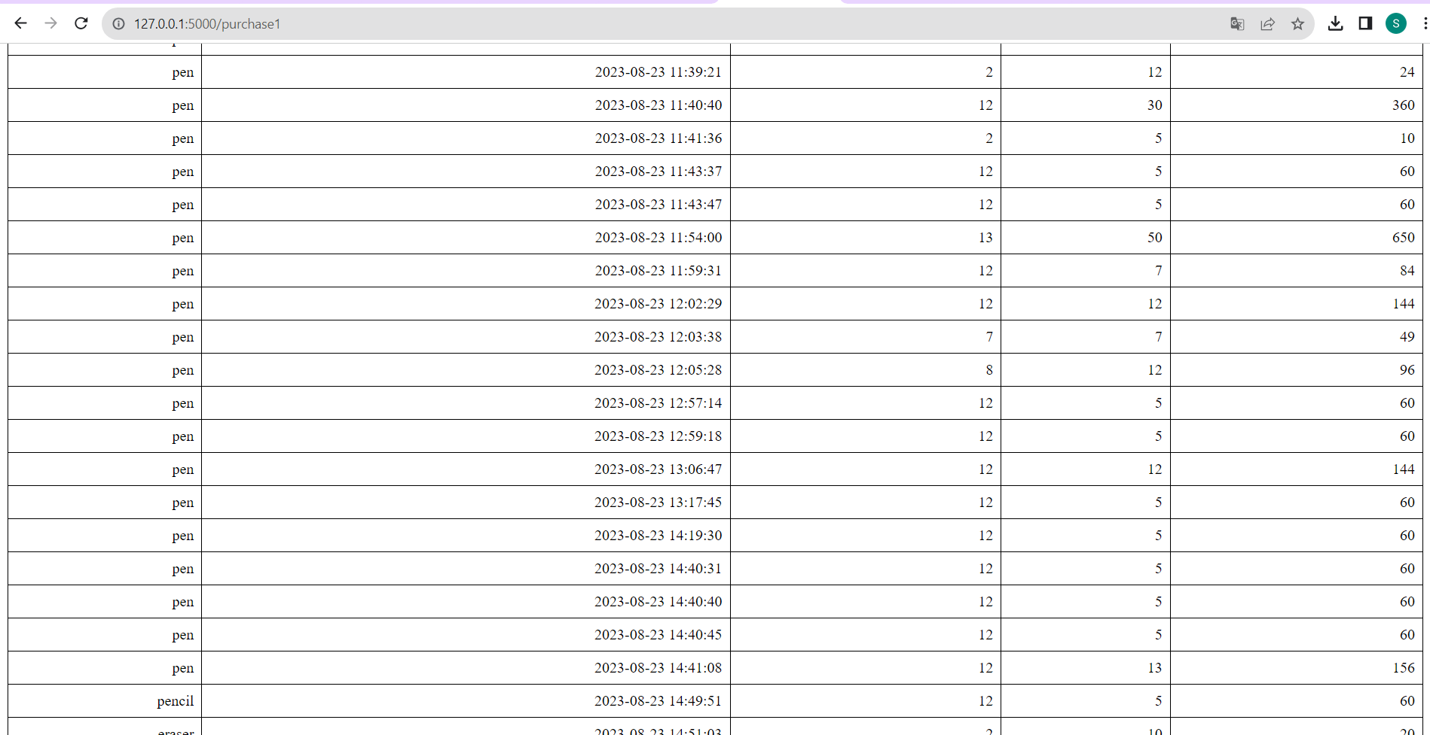
Products which are purchased

Slide 5
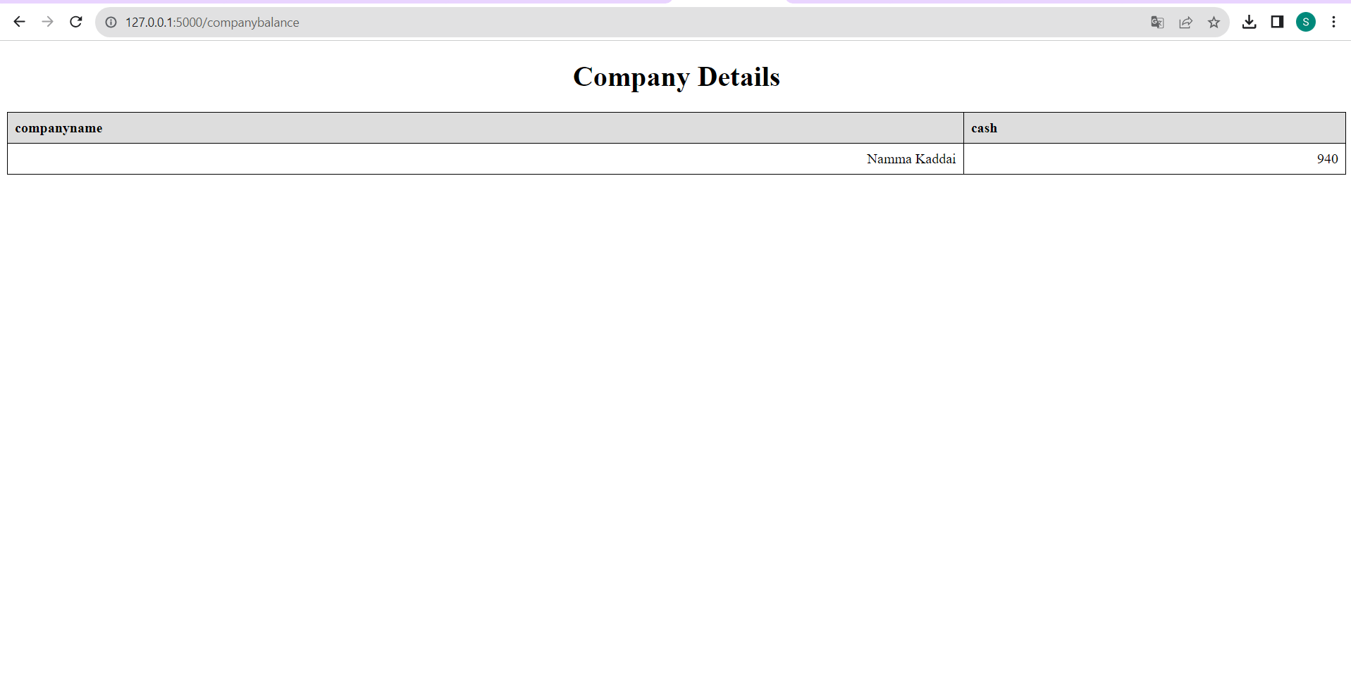
Company cash updates

Slide 6
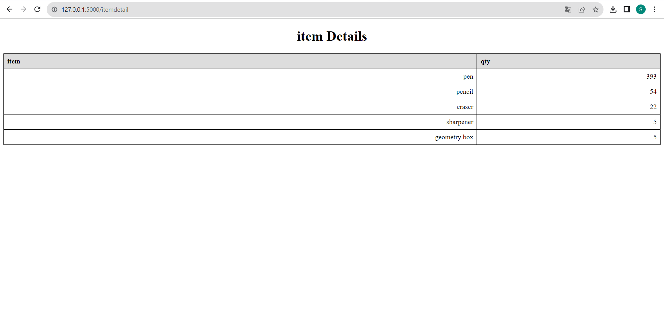
Product quantity

